Slide 1
Bank Management System
Software Modeling and Design Project
Team Members: ErVis, Fabio, Alonso, David, Enklajd, Florjoni, Erdi
March 2025

Slide 2
Introduction
The Bank Management System (BMS) is a software solution designed to automate and streamline banking operations, ensuring efficient customer service, secure transactions, and regulatory compliance. This system will allow customers to manage their accounts, transfer funds, apply for loans, and receive notifications while enabling bank employees to manage transactions, loan approvals, and account security.

Slide 3
Objectives
•To provide secure and efficient banking services for customers.
•To automate fund transfers, account management, and loan applications.
•To enhance security with encryption and fraud detection mechanisms.
•To improve customer experience through an intuitive online banking platform.
•To ensure compliance with financial regulations and reporting requirements.

Slide 4
Scope
Included Features:
✅ Customer Features:
•Secure Login & Authentication (with OTP)
•Account Overview (Balance, Transaction History)
•Fund Transfers (Internal & External)
•Loan Application & Repayment Tracking
•Notifications & Alerts
✅ Bank Employee Features:
•Customer Management (New Accounts, Profile Updates)
•Transaction Monitoring & Approvals
•Loan Processing & Approval System
•Report Generation

Slide 5

✅ Admin Features:
•User & Role Management
•Fraud Detection & Security Logs
•Compliance & Audit Reporting
Excluded Features:
❌ Cryptocurrency transactions
❌ Stock market trading integration
❌ ATM management

Slide 6
Target Users
•Bank Customers: Individuals & businesses managing their finances.
•Bank Employees: Customer service agents, loan officers, and account managers.
•System Administrators: IT personnel managing security and compliance.

Slide 7
Product / Service Description
Product Context
How does this product relate to other products? Is it independent or self-contained? Does it interface with a variety of related systems? Describe these relationships or use a diagram to show the major components of the larger system, interconnections, and external interfaces.
User Characteristics
Create general customer profiles for each type of user who will be using the product. Profiles should include:
Student/faculty/staff/other
experience
technical expertise
other general characteristics that may influence the product

Slide 8
Assumptions
List any assumptions that affect the requirements, for example, equipment availability, user expertise, etc. For example, a specific operating system is assumed to be available; if the operating system is not available, the Requirements Specification would then have to change accordingly.
Constraints and Dependencies
List constraints and dependencies that affect the requirements. Examples:
parallel operation with an old system
audit functions (audit trail, log files, etc.)
access, management and security
criticality of the application

Slide 9
FUNCTIONAL Requirements
Customer shall be able to view account balance because they need to check their available fund
Customer shall be able to transfer money to another account because they need to make transactions
Customer shall be able to request a loan because they need financial assistance
Customer shall be able to view loan details because they need to track the status and amount of their loan
Customer shall be able to withdraw money from their account because they need access to their funds
Customer shall be able to deposit money into their account because they need to increase their balance

Slide 10
Customer shall be able to change their account PIN because they need to secure their account
Customer shall be able to request a checkbook because they need to make payments via checks
Bank Employee shall be able to approve or reject account creation request because accounts must be verified before activation
Bank Employee shall be able to view all client accounts because they need to manage customer data
Bank Employee shall be able to update client account information because clients may request changes to personal details
Bank Employee shall be able to check client loan status because they need to manage loan repayments and approvals

Slide 11
Administrator shall be able to manage employee accounts because they need to assign roles and permissions
Admin shall be able to monitor all transactions because fraud detection and auditing are necessary
Admin shall be able to freeze or close accounts because fraudulent activities or client requests may require account suspension
Administrator shall be able to generate reports on transactions because financial oversight
System shall be able to validate account details during creation because to prevent errors and fraud
System shall be able to send transaction alerts to customers because customers need to be notified of account activity

Slide 12
System shall be able to generate monthly account statements for customers because customers need a record of their financial activities
System shall be able to apply security measures for online transactions because to prevent unauthorized access
System shall be able to set loan eligibility criteria because to ensure that loans are given based on financial capability.
System shall be able to apply interest rates to loan accounts because to calculate the amount to be paid back.
Customer shall be able to view transaction history because they need to keep track of all their financial transactions.
Customer shall be able to set account preferences (e.g., notifications) because they need to customize their experience

Slide 13
Customer shall be able to request account suspension because they may need to temporarily disable their account.
Bank Employee shall be able to approve or deny loan applications because they need to assess loan risk.
System shall be able to calculate loan repayment schedules because customers need clear repayment plans.
System shall be able to perform automatic currency conversion for international transactions because customers need to send and receive funds across borders.
System shall be able to block suspicious transactions because fraudulent activities need to be prevented.

Slide 14
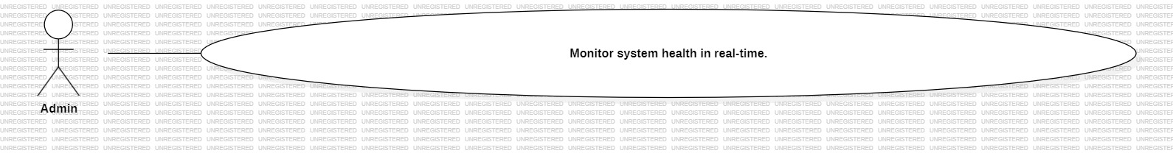
Use Case ID: UC_01 Use Case Title: Admin shall be able to monitor system health in real-time, to ensure uptime and performance. Primary Actor: Customer Description: This use case describes how the Customer will monitor system health in real-time, to ensure uptime and performance. Preconditions: - The Customer must be authenticated and logged into the system. Postconditions: - The system successfully completes the action described, or returns an appropriate error if it fails. Main Flow: 1. Customer navigates to the relevant section of the Bank Management System. 2. The system displays the available options. 3. Customer selects the option to monitor system health in real-time, to ensure uptime and performance 4. The system processes the request and provides confirmation or feedback. Alternate Flow: - If any input is invalid, the system displays an error and prompts the Customer to correct it. Exceptions: - System is down or unavailable. - User session has expired. - Action not permitted due to role or restrictions

Slide 15
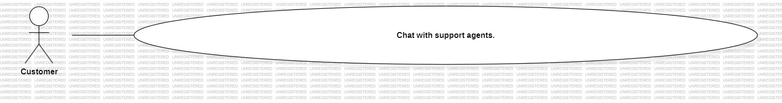
Use Case ID: UC_02 Use Case Title: Customer shall be able to chat with support agents, for real-time assistance within the app. Primary Actor: Customer Description: This use case describes how the Customer will chat with support agents, for real-time assistance within the app. Preconditions: - The Customer must be authenticated and logged into the system. Postconditions: - The system successfully completes the action described, or returns an appropriate error if it fails. Main Flow: 1. Customer navigates to the relevant section of the Bank Management System. 2. The system displays the available options. 3. Customer selects the option to chat with support agents, for real-time assistance within the app 4. The system processes the request and provides confirmation or feedback. Alternate Flow: - If any input is invalid, the system displays an error and prompts the Customer to correct it. Exceptions: - System is down or unavailable. - User session has expired. - Action not permitted due to role or restrictions.

Slide 16
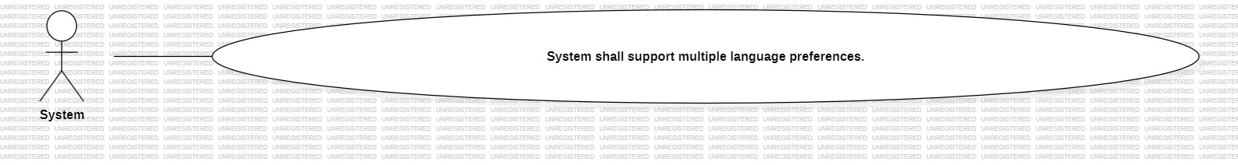
Use Case ID: UC_03 Use Case Title: System shall support multiple language preferences, to make banking accessible for diverse users. Primary Actor: System Description: This use case describes how the System will System shall support multiple language preferences, to make banking accessible for diverse users. Preconditions: - The System must be authenticated and logged into the system. Postconditions: - The system successfully completes the action described, or returns an appropriate error if it fails. Main Flow: 1. System navigates to the relevant section of the Bank Management System. 2. The system displays the available options. 3. System selects the option to System shall support multiple language preferences, to make banking accessible for diverse users 4. The system processes the request and provides confirmation or feedback. Alternate Flow: - If any input is invalid, the system displays an error and prompts the System to correct it. Exceptions: - System is down or unavailable. - User session has expired. - Action not permitted due to role or restrictions.

Slide 17
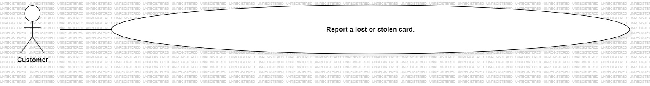
Use Case ID: UC_04 Use Case Title: Customer shall be able to report a lost/stolen card, to prevent unauthorized usage. Primary Actor: Customer Description: This use case describes how the Customer will report a lost/stolen card, to prevent unauthorized usage. Preconditions: - The Customer must be authenticated and logged into the system. Postconditions: - The system successfully completes the action described, or returns an appropriate error if it fails. Main Flow: 1. Customer navigates to the relevant section of the Bank Management System. 2. The system displays the available options. 3. Customer selects the option to report a lost/stolen card, to prevent unauthorized usage 4. The system processes the request and provides confirmation or feedback. Alternate Flow: - If any input is invalid, the system displays an error and prompts the Customer to correct it. Exceptions: - System is down or unavailable. - User session has expired. - Action not permitted due to role or restrictions.

Slide 18
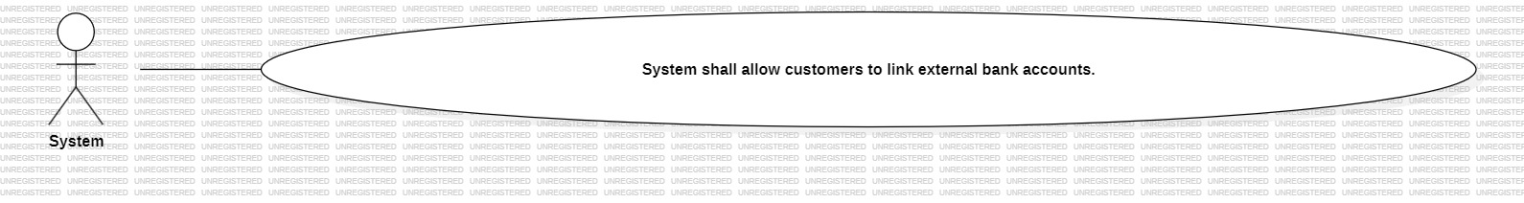
Use Case ID: UC_05 Use Case Title: System shall allow customers to link external bank accounts, to view consolidated balances. Primary Actor: System Description: This use case describes how the System will System shall allow customers to link external bank accounts, to view consolidated balances. Preconditions: - The System must be authenticated and logged into the system. Postconditions: - The system successfully completes the action described, or returns an appropriate error if it fails. Main Flow: 1. System navigates to the relevant section of the Bank Management System. 2. The system displays the available options. 3. System selects the option to System shall allow customers to link external bank accounts, to view consolidated balances 4. The system processes the request and provides confirmation or feedback. Alternate Flow: - If any input is invalid, the system displays an error and prompts the System to correct it. Exceptions: - System is down or unavailable. - User session has expired. - Action not permitted due to role or restrictions.

Slide 19

Use Case ID: UC_06 Use Case Title: Customer shall be able to enable biometric authentication, to increase login security. Primary Actor: Customer Description: This use case describes how the Customer will enable biometric authentication, to increase login security. Preconditions: - The Customer must be authenticated and logged into the system. Postconditions: - The system successfully completes the action described, or returns an appropriate error if it fails. Main Flow: 1. Customer navigates to the relevant section of the Bank Management System. 2. The system displays the available options. 3. Customer selects the option to enable biometric authentication, to increase login security 4. The system processes the request and provides confirmation or feedback. Alternate Flow: - If any input is invalid, the system displays an error and prompts the Customer to correct it. Exceptions: - System is down or unavailable. - User session has expired. - Action not permitted due to role or restrictions.

Slide 20

Use Case ID: UC_07 Use Case Title: Customer shall be able to receive spending reports, to help track personal budgeting. Primary Actor: Customer Description: This use case describes how the Customer will receive spending reports, to help track personal budgeting. Preconditions: - The Customer must be authenticated and logged into the system. Postconditions: - The system successfully completes the action described, or returns an appropriate error if it fails. Main Flow: 1. Customer navigates to the relevant section of the Bank Management System. 2. The system displays the available options. 3. Customer selects the option to receive spending reports, to help track personal budgeting 4. The system processes the request and provides confirmation or feedback. Alternate Flow: - If any input is invalid, the system displays an error and prompts the Customer to correct it. Exceptions: - System is down or unavailable. - User session has expired. - Action not permitted due to role or restrictions.

Slide 21
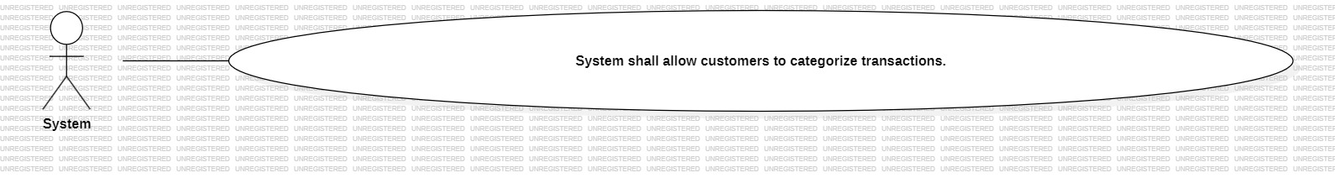
Use Case ID: UC_08 Use Case Title: System shall allow customers to categorize transactions (e.g., groceries, utilities) for better financial insights. Primary Actor: System Description: This use case describes how the System will System shall allow customers to categorize transactions (e.g., groceries, utilities) for better financial insights. Preconditions: - The System must be authenticated and logged into the system. Postconditions: - The system successfully completes the action described, or returns an appropriate error if it fails. Main Flow: 1. System navigates to the relevant section of the Bank Management System. 2. The system displays the available options. 3. System selects the option to System shall allow customers to categorize transactions (e.g., groceries, utilities) for better financial insights 4. The system processes the request and provides confirmation or feedback. Alternate Flow: - If any input is invalid, the system displays an error and prompts the System to correct it. Exceptions: - System is down or unavailable. - User session has expired. - Action not permitted due to role or restrictions.

Slide 22

Use Case ID: UC_09 Use Case Title: Customer shall be able to schedule future fund transfers, to automate recurring payments. Primary Actor: System Description: This use case describes how the System will schedule future fund transfers, to automate recurring payments. Preconditions: - The System must be authenticated and logged into the system. Postconditions: - The system successfully completes the action described, or returns an appropriate error if it fails. Main Flow: 1. System navigates to the relevant section of the Bank Management System. 2. The system displays the available options. 3. System selects the option to schedule future fund transfers, to automate recurring payments 4. The system processes the request and provides confirmation or feedback. Alternate Flow: - If any input is invalid, the system displays an error and prompts the System to correct it. Exceptions: - System is down or unavailable. - User session has expired. - Action not permitted due to role or restrictions.

Slide 23

Use Case ID: UC_10 Use Case Title: Customer shall be able to set account preferences (e.g., notifications) because they need to customize their experience. Primary Actor: Admin Description: This use case describes how the Admin will set account preferences (e.g., notifications) because they need to customize their experience. Preconditions: - The Admin must be authenticated and logged into the system. Postconditions: - The system successfully completes the action described, or returns an appropriate error if it fails. Main Flow: 1. Admin navigates to the relevant section of the Bank Management System. 2. The system displays the available options. 3. Admin selects the option to set account preferences (e.g., notifications) because they need to customize their experience 4. The system processes the request and provides confirmation or feedback. Alternate Flow: - If any input is invalid, the system displays an error and prompts the Admin to correct it. Exceptions: - System is down or unavailable. - User session has expired. - Action not permitted due to role or restrictions.

Slide 24
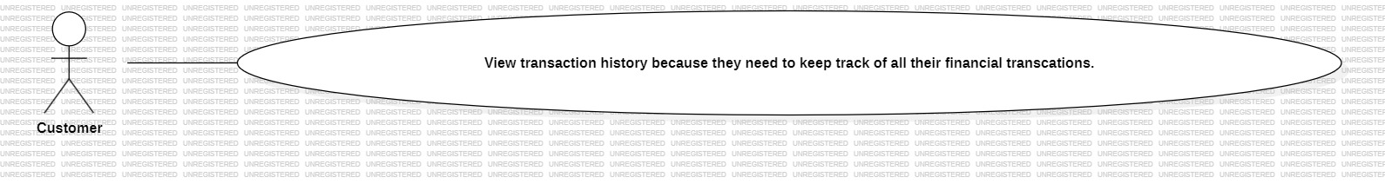
Use Case ID: UC_11 Use Case Title: Customer shall be able to view transaction history because they need to keep track of all their financial transactions. Primary Actor: Customer Description: This use case describes how the Customer will view transaction history because they need to keep track of all their financial transactions. Preconditions: - The Customer must be authenticated and logged into the system. Postconditions: - The system successfully completes the action described, or returns an appropriate error if it fails. Main Flow: 1. Customer navigates to the relevant section of the Bank Management System. 2. The system displays the available options. 3. Customer selects the option to view transaction history because they need to keep track of all their financial transactions 4. The system processes the request and provides confirmation or feedback. Alternate Flow: - If any input is invalid, the system displays an error and prompts the Customer to correct it. Exceptions: - System is down or unavailable. - User session has expired. - Action not permitted due to role or restrictions.

Slide 25
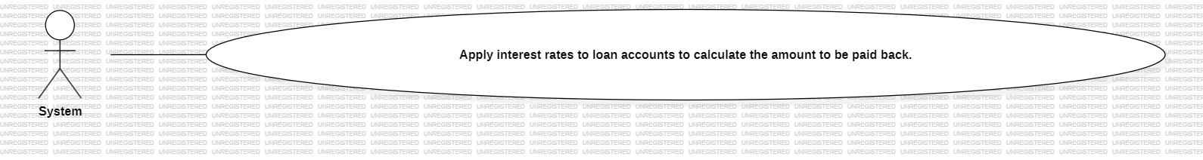
Use Case ID: UC_12 Use Case Title: System shall be able to apply interest rates to loan accounts because to calculate the amount to be paid back. Primary Actor: Customer Description: This use case describes how the Customer will apply interest rates to loan accounts because to calculate the amount to be paid back. Preconditions: - The Customer must be authenticated and logged into the system. Postconditions: - The system successfully completes the action described, or returns an appropriate error if it fails. Main Flow: 1. Customer navigates to the relevant section of the Bank Management System. 2. The system displays the available options. 3. Customer selects the option to apply interest rates to loan accounts because to calculate the amount to be paid back 4. The system processes the request and provides confirmation or feedback. Alternate Flow: - If any input is invalid, the system displays an error and prompts the Customer to correct it. Exceptions: - System is down or unavailable. - User session has expired. - Action not permitted due to role or restrictions.

Slide 26
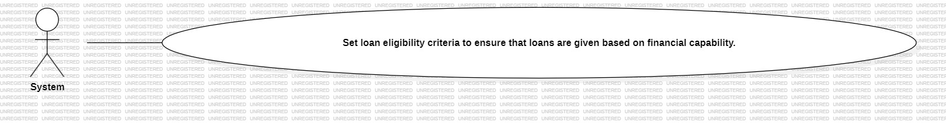
Use Case ID: UC_13 Use Case Title: System shall be able to set loan eligibility criteria because to ensure that loans are given based on financial capability. Primary Actor: Customer Description: This use case describes how the Customer will set loan eligibility criteria because to ensure that loans are given based on financial capability. Preconditions: - The Customer must be authenticated and logged into the system. Postconditions: - The system successfully completes the action described, or returns an appropriate error if it fails. Main Flow: 1. Customer navigates to the relevant section of the Bank Management System. 2. The system displays the available options. 3. Customer selects the option to set loan eligibility criteria because to ensure that loans are given based on financial capability 4. The system processes the request and provides confirmation or feedback. Alternate Flow: - If any input is invalid, the system displays an error and prompts the Customer to correct it. Exceptions: - System is down or unavailable. - User session has expired. - Action not permitted due to role or restrictions.

Slide 27
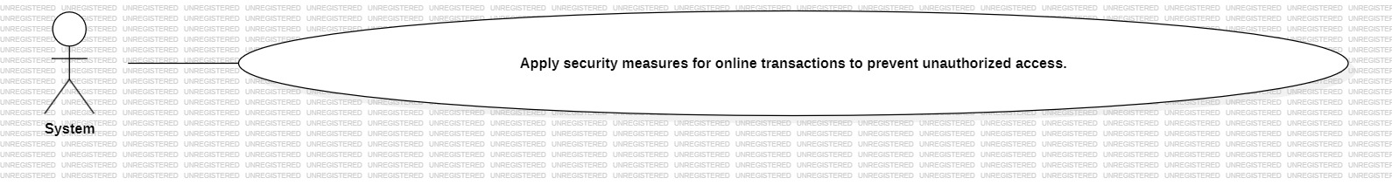
Use Case ID: UC_14 Use Case Title: System shall be able to apply security measures for online transactions because to prevent unauthorized access. Primary Actor: System Description: This use case describes how the System will apply security measures for online transactions because to prevent unauthorized access. Preconditions: - The System must be authenticated and logged into the system. Postconditions: - The system successfully completes the action described, or returns an appropriate error if it fails. Main Flow: 1. System navigates to the relevant section of the Bank Management System. 2. The system displays the available options. 3. System selects the option to apply security measures for online transactions because to prevent unauthorized access 4. The system processes the request and provides confirmation or feedback. Alternate Flow: - If any input is invalid, the system displays an error and prompts the System to correct it. Exceptions: - System is down or unavailable. - User session has expired. - Action not permitted due to role or restrictions.

Slide 28
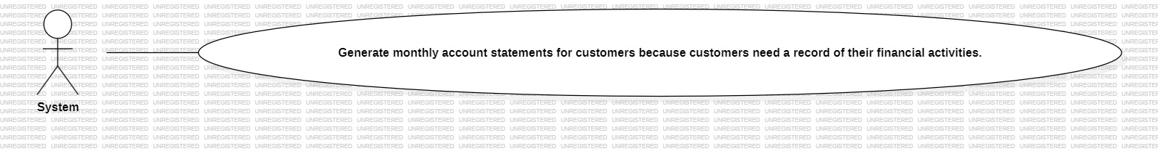
Use Case ID: UC_15 Use Case Title: System shall be able to generate monthly account statements for customers because customers need a record of their financial activities. Primary Actor: System Description: This use case describes how the System will generate monthly account statements for customers because customers need a record of their financial activities. Preconditions: - The System must be authenticated and logged into the system. Postconditions: - The system successfully completes the action described, or returns an appropriate error if it fails. Main Flow: 1. System navigates to the relevant section of the Bank Management System. 2. The system displays the available options. 3. System selects the option to generate monthly account statements for customers because customers need a record of their financial activities 4. The system processes the request and provides confirmation or feedback. Alternate Flow: - If any input is invalid, the system displays an error and prompts the System to correct it. Exceptions: - System is down or unavailable. - User session has expired. - Action not permitted due to role or restrictions.

Slide 29
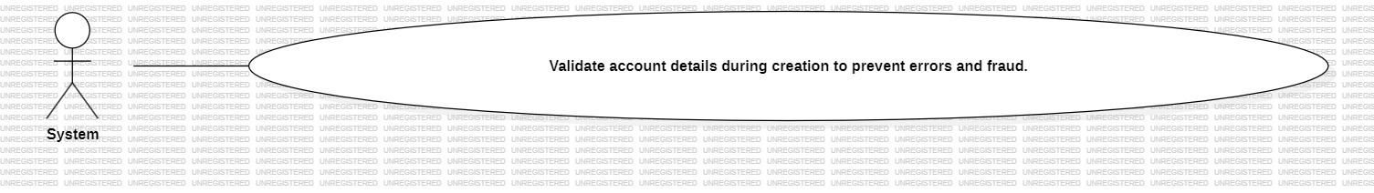
Use Case ID: UC_16 Use Case Title: System shall be able to validate account details during creation because to prevent errors and fraud. Primary Actor: Customer Description: This use case describes how the Customer will validate account details during creation because to prevent errors and fraud. Preconditions: - The Customer must be authenticated and logged into the system. Postconditions: - The system successfully completes the action described, or returns an appropriate error if it fails. Main Flow: 1. Customer navigates to the relevant section of the Bank Management System. 2. The system displays the available options. 3. Customer selects the option to validate account details during creation because to prevent errors and fraud 4. The system processes the request and provides confirmation or feedback. Alternate Flow: - If any input is invalid, the system displays an error and prompts the Customer to correct it. Exceptions: - System is down or unavailable. - User session has expired. - Action not permitted due to role or restrictions.

Slide 30
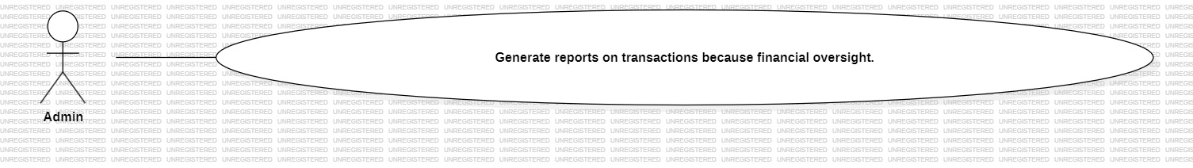
Use Case ID: UC_17 Use Case Title: Administrator shall be able to generate reports on transactions because financial oversight. Primary Actor: Customer Description: This use case describes how the Customer will generate reports on transactions because financial oversight. Preconditions: - The Customer must be authenticated and logged into the system. Postconditions: - The system successfully completes the action described, or returns an appropriate error if it fails. Main Flow: 1. Customer navigates to the relevant section of the Bank Management System. 2. The system displays the available options. 3. Customer selects the option to generate reports on transactions because financial oversight 4. The system processes the request and provides confirmation or feedback. Alternate Flow: - If any input is invalid, the system displays an error and prompts the Customer to correct it. Exceptions: - System is down or unavailable. - User session has expired. - Action not permitted due to role or restrictions.

Slide 31
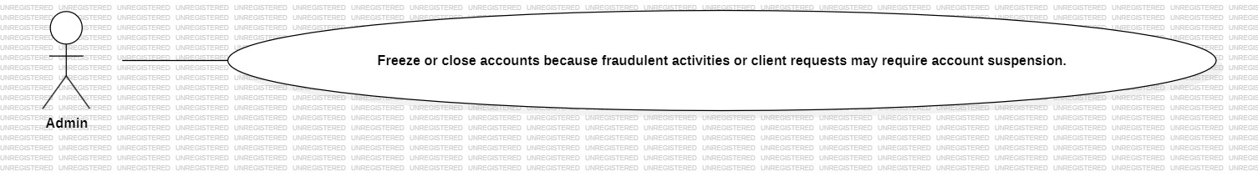
Use Case ID: UC_18 Use Case Title: Admin shall be able to freeze or close accounts because fraudulent activities or client requests may require account suspension. Primary Actor: Admin Description: This use case describes how the Admin will freeze or close accounts because fraudulent activities or client requests may require account suspension. Preconditions: - The Admin must be authenticated and logged into the system. Postconditions: - The system successfully completes the action described, or returns an appropriate error if it fails. Main Flow: 1. Admin navigates to the relevant section of the Bank Management System. 2. The system displays the available options. 3. Admin selects the option to freeze or close accounts because fraudulent activities or client requests may require account suspension 4. The system processes the request and provides confirmation or feedback. Alternate Flow: - If any input is invalid, the system displays an error and prompts the Admin to correct it. Exceptions: - System is down or unavailable. - User session has expired. - Action not permitted due to role or restrictions.

Slide 32
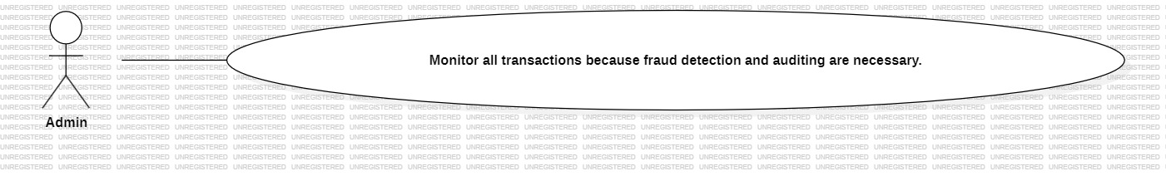
Use Case ID: UC_19 Use Case Title: Admin shall be able to monitor all transactions because fraud detection and auditing are necessary. Primary Actor: Admin Description: This use case describes how the Admin will monitor all transactions because fraud detection and auditing are necessary. Preconditions: - The Admin must be authenticated and logged into the system. Postconditions: - The system successfully completes the action described, or returns an appropriate error if it fails. Main Flow: 1. Admin navigates to the relevant section of the Bank Management System. 2. The system displays the available options. 3. Admin selects the option to monitor all transactions because fraud detection and auditing are necessary 4. The system processes the request and provides confirmation or feedback. Alternate Flow: - If any input is invalid, the system displays an error and prompts the Admin to correct it. Exceptions: - System is down or unavailable. - User session has expired. - Action not permitted due to role or restrictions.

Slide 33
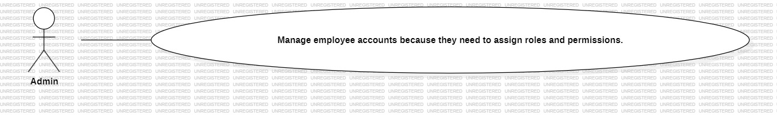
Use Case ID: UC_20 Use Case Title: Administrator shall be able to manage employee accounts because they need to assign roles and permissions. Primary Actor: Admin Description: This use case describes how the Admin will manage employee accounts because they need to assign roles and permissions. Preconditions: - The Admin must be authenticated and logged into the system. Postconditions: - The system successfully completes the action described, or returns an appropriate error if it fails. Main Flow: 1. Admin navigates to the relevant section of the Bank Management System. 2. The system displays the available options. 3. Admin selects the option to manage employee accounts because they need to assign roles and permissions 4. The system processes the request and provides confirmation or feedback. Alternate Flow: - If any input is invalid, the system displays an error and prompts the Admin to correct it. Exceptions: - System is down or unavailable. - User session has expired. - Action not permitted due to role or restrictions.

Slide 34
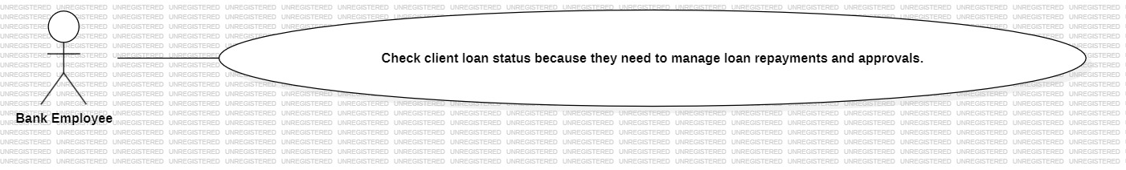
Use Case ID: UC_21 Use Case Title: Bank Employee shall be able to check client loan status because they need to manage loan repayments and approvals. Primary Actor: Bank Employee Description: This use case describes how the Bank Employee will check client loan status because they need to manage loan repayments and approvals. Preconditions: - The Bank Employee must be authenticated and logged into the system. Postconditions: - The system successfully completes the action described, or returns an appropriate error if it fails. Main Flow: 1. Bank Employee navigates to the relevant section of the Bank Management System. 2. The system displays the available options. 3. Bank Employee selects the option to check client loan status because they need to manage loan repayments and approvals 4. The system processes the request and provides confirmation or feedback. Alternate Flow: - If any input is invalid, the system displays an error and prompts the Bank Employee to correct it. Exceptions: - System is down or unavailable. - User session has expired. - Action not permitted due to role or restrictions.

Slide 35
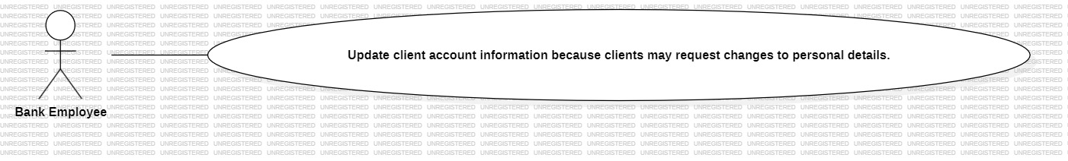
Use Case ID: UC_22 Use Case Title: Bank Employee shall be able to update client account information because clients may request changes to personal details. Primary Actor: Bank Employee Description: This use case describes how the Bank Employee will update client account information because clients may request changes to personal details. Preconditions: - The Bank Employee must be authenticated and logged into the system. Postconditions: - The system successfully completes the action described, or returns an appropriate error if it fails. Main Flow: 1. Bank Employee navigates to the relevant section of the Bank Management System. 2. The system displays the available options. 3. Bank Employee selects the option to update client account information because clients may request changes to personal details 4. The system processes the request and provides confirmation or feedback. Alternate Flow: - If any input is invalid, the system displays an error and prompts the Bank Employee to correct it. Exceptions: - System is down or unavailable. - User session has expired. - Action not permitted due to role or restrictions.

Slide 36
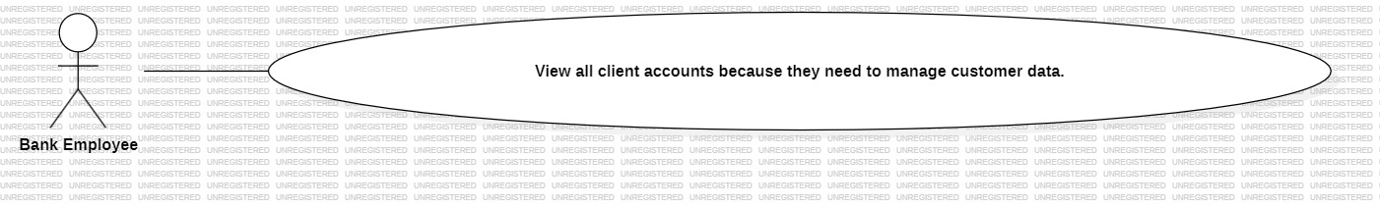
Use Case ID: UC_23 Use Case Title: Bank Employee shall be able to view all client accounts because they need to manage customer data. Primary Actor: Bank Employee Description: This use case describes how the Bank Employee will view all client accounts because they need to manage customer data. Preconditions: - The Bank Employee must be authenticated and logged into the system. Postconditions: - The system successfully completes the action described, or returns an appropriate error if it fails. Main Flow: 1. Bank Employee navigates to the relevant section of the Bank Management System. 2. The system displays the available options. 3. Bank Employee selects the option to view all client accounts because they need to manage customer data 4. The system processes the request and provides confirmation or feedback. Alternate Flow: - If any input is invalid, the system displays an error and prompts the Bank Employee to correct it. Exceptions: - System is down or unavailable. - User session has expired. - Action not permitted due to role or restrictions.

Slide 37
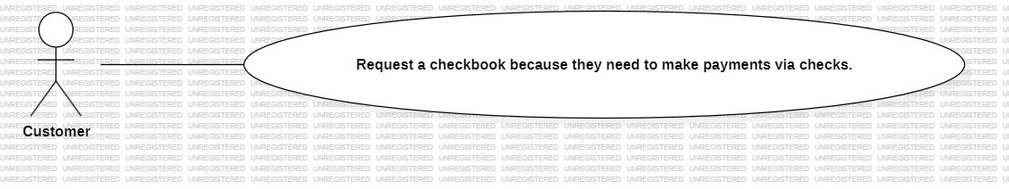
Use Case ID: UC_24 Use Case Title: Customer shall be able to request a checkbook because they need to make payments via checks. Primary Actor: Customer Description: This use case describes how the Customer will request a checkbook because they need to make payments via checks. Preconditions: - The Customer must be authenticated and logged into the system. Postconditions: - The system successfully completes the action described, or returns an appropriate error if it fails. Main Flow: 1. Customer navigates to the relevant section of the Bank Management System. 2. The system displays the available options. 3. Customer selects the option to request a checkbook because they need to make payments via checks 4. The system processes the request and provides confirmation or feedback. Alternate Flow: - If any input is invalid, the system displays an error and prompts the Customer to correct it. Exceptions: - System is down or unavailable. - User session has expired. - Action not permitted due to role or restrictions.

Slide 38
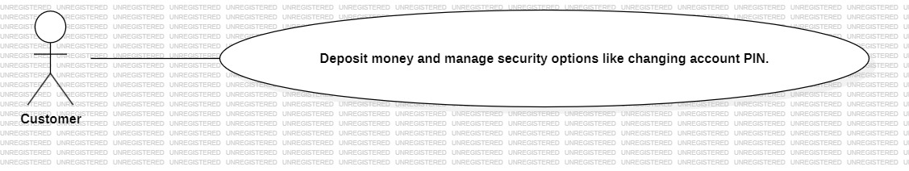
Use Case ID: UC_25 Use Case Title: Customer (Account Manager) shall be able to deposit money and manage security options like changing account PIN. Primary Actor: Customer Description: This use case describes how the Customer will deposit money and manage security options like changing account PIN. Preconditions: - The Customer must be authenticated and logged into the system. Postconditions: - The system successfully completes the action described, or returns an appropriate error if it fails. Main Flow: 1. Customer navigates to the relevant section of the Bank Management System. 2. The system displays the available options. 3. Customer selects the option to deposit money and manage security options like changing account PIN 4. The system processes the request and provides confirmation or feedback. Alternate Flow: - If any input is invalid, the system displays an error and prompts the Customer to correct it. Exceptions: - System is down or unavailable. - User session has expired. - Action not permitted due to role or restrictions.

Slide 39
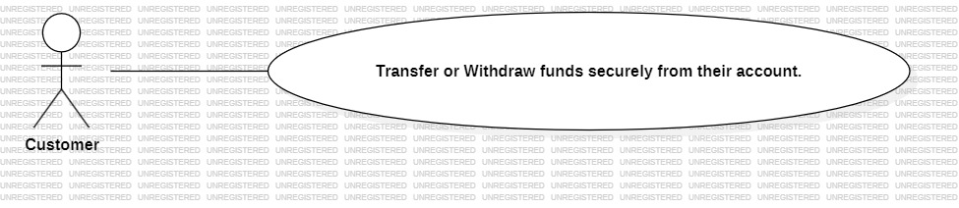
Use Case ID: UC_26 Use Case Title: Customer shall be able to transfer or withdraw funds securely from their account. Primary Actor: Customer Description: This use case describes how the Customer will transfer or withdraw funds securely from their account. Preconditions: - The Customer must be authenticated and logged into the system. Postconditions: - The system successfully completes the action described, or returns an appropriate error if it fails. Main Flow: 1. Customer navigates to the relevant section of the Bank Management System. 2. The system displays the available options. 3. Customer selects the option to transfer or withdraw funds securely from their account 4. The system processes the request and provides confirmation or feedback. Alternate Flow: - If any input is invalid, the system displays an error and prompts the Customer to correct it. Exceptions: - System is down or unavailable. - User session has expired. - Action not permitted due to role or restrictions.

Slide 40
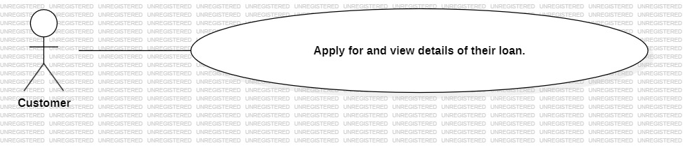
Use Case ID: UC_27 Use Case Title: Customer shall be able to apply for and view details of their loan, to track its status and repayment. Primary Actor: Customer Description: This use case describes how the Customer will apply for and view details of their loan, to track its status and repayment. Preconditions: - The Customer must be authenticated and logged into the system. Postconditions: - The system successfully completes the action described, or returns an appropriate error if it fails. Main Flow: 1. Customer navigates to the relevant section of the Bank Management System. 2. The system displays the available options. 3. Customer selects the option to apply for and view details of their loan, to track its status and repayment 4. The system processes the request and provides confirmation or feedback. Alternate Flow: - If any input is invalid, the system displays an error and prompts the Customer to correct it. Exceptions: - System is down or unavailable. - User session has expired. - Action not permitted due to role or restrictions.

Slide 41
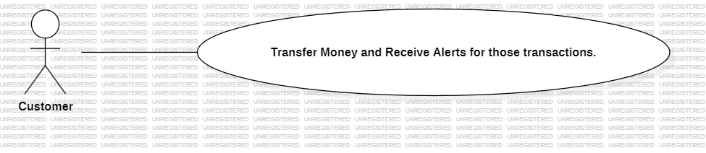
Use Case ID: UC_28 Use Case Title: Customer shall be able to transfer money and receive alerts for those transactions. Primary Actor: System Description: This use case describes how the System will transfer money and receive alerts for those transactions. Preconditions: - The System must be authenticated and logged into the system. Postconditions: - The system successfully completes the action described, or returns an appropriate error if it fails. Main Flow: 1. System navigates to the relevant section of the Bank Management System. 2. The system displays the available options. 3. System selects the option to transfer money and receive alerts for those transactions 4. The system processes the request and provides confirmation or feedback. Alternate Flow: - If any input is invalid, the system displays an error and prompts the System to correct it. Exceptions: - System is down or unavailable. - User session has expired. - Action not permitted due to role or restrictions.

Slide 42
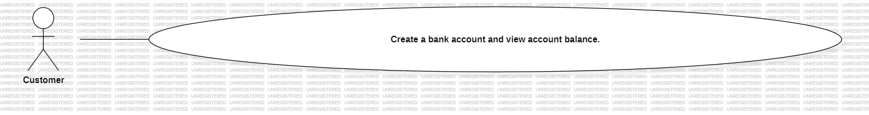
Use Case ID: UC_29 Use Case Title: Customer shall be able to create a bank account and view account balance, to manage and track their funds. Primary Actor: System Description: This use case describes how the System will create a bank account and view account balance, to manage and track their funds. Preconditions: - The System must be authenticated and logged into the system. Postconditions: - The system successfully completes the action described, or returns an appropriate error if it fails. Main Flow: 1. System navigates to the relevant section of the Bank Management System. 2. The system displays the available options. 3. System selects the option to create a bank account and view account balance, to manage and track their funds 4. The system processes the request and provides confirmation or feedback. Alternate Flow: - If any input is invalid, the system displays an error and prompts the System to correct it. Exceptions: - System is down or unavailable. - User session has expired. - Action not permitted due to role or restrictions.

Slide 43
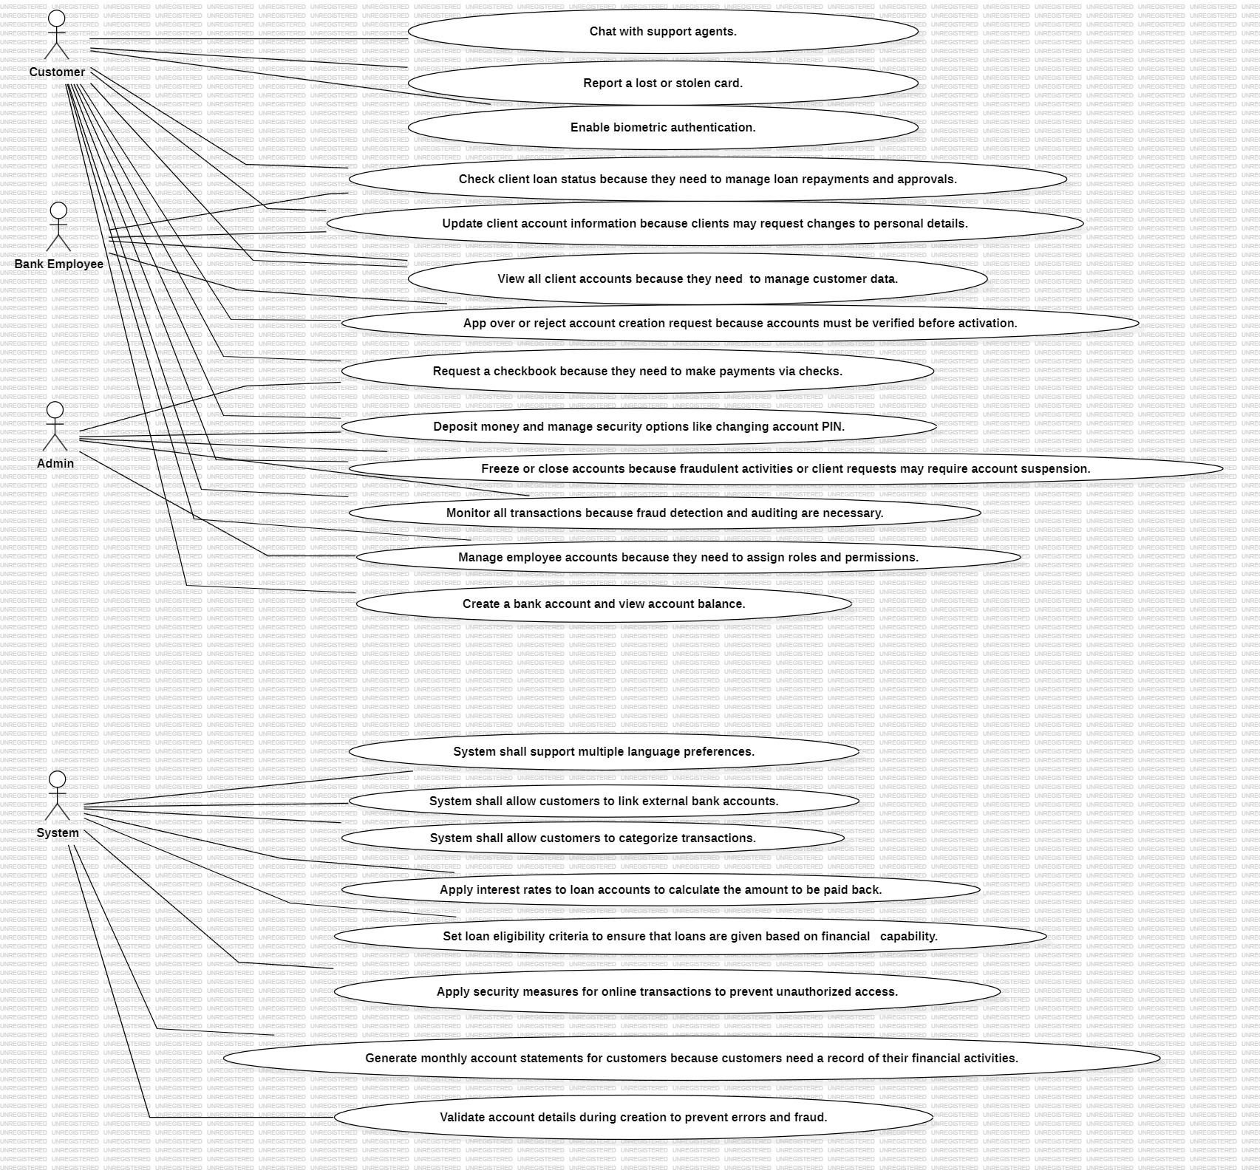

Slide 44
Non-Functional Requirements
Product Requirements.
3.2.1.1 Usability Requirements
The system should be easy to use for customers, requiring minimal training to perform common actions
The user documentation and help section should be complete and accessible to help users understand all system features
The system should have an intuitive interface that minimizes the learning curve for new users
The system should provide helpful error messages when an invalid action is performed

Slide 45
Non-Functional Requirements
Performance Requirements
The system should be able to handle at least 1000 simultaneous users without degradation in performance
95% of transactions shall be processed in less than 1 sec
The system should be able to process at least 10000 transactions per day during break periods
The system should handle data storage requirements of up to 1TB of transactionsal data without performance issues

Slide 46
Non-Functional Requirements
3.2.1.3 Availability
The system should have an availability of 99.9%, ensuring minimal downtime
The system should support access from multiple geographic regions, including remote branches and online banking services
Scheduled maintenance should be communicated to users at least 24 hours in advance, and downtime should not exceed 2 hours per month
The maximum allowed downtime for unscheduled outages should be 4 hours per year.
The system should be able to recover from failure within 5 minutes to minimize impact on user activities

Slide 47
Non-Functional Requirements
Security
All user data and transactions should be encrypted using AES-256 encryption
The system should log all user activity for auditing and troubleshooting purposes, with logs being stored for a minimum of 1 year.
Access to the system’s backend should be restricted to authorized bank employees only, with role-based access control
The system should conduct integrity checks on user data and transactional records to ensure no unauthorized modifications occur
Two-factor authentication should be required for all admin-level users

Slide 48
Non-Functional Requirements
Organizational Requirements
The bank’s internal policies must be adhered to during the development, ensuring compliance with financial regulations
The system should be compatible with the bank’s existing infrastructure, including hardware and software systems
The development process must follow the Agile methodology for continuous improvement and rapid feedback cycles
The system should support integration with existing third-party systems, such as payment gateways and credit scoring providers.

Slide 49
Non-Functional Requirements
External Requirements
The system should comply with the GDPR for data protection and privacy of EU customers
The system must comply with industry standards such as PCI DSS for secure handling of payment card data.
The system should integrate with government systems for tax reporting and financial audits where necessary.
The system should support interoperability with other banks for cross-bank transfers (e.g., SWIFT, SEPA).
The system must ensure that all software components comply with local and international banking regulations.

